Slide 1
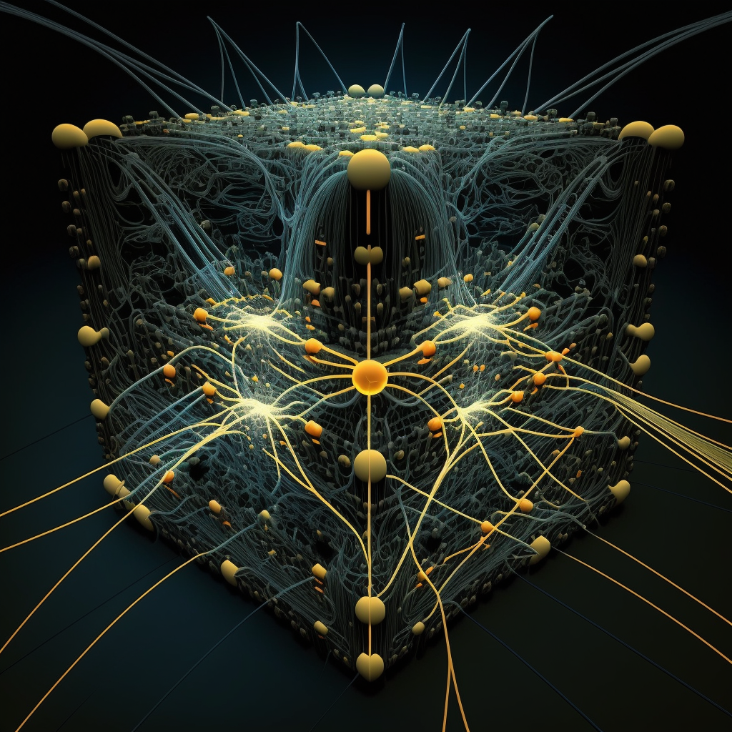
deep neural networks
midjourney bot (2023)

Slide 2
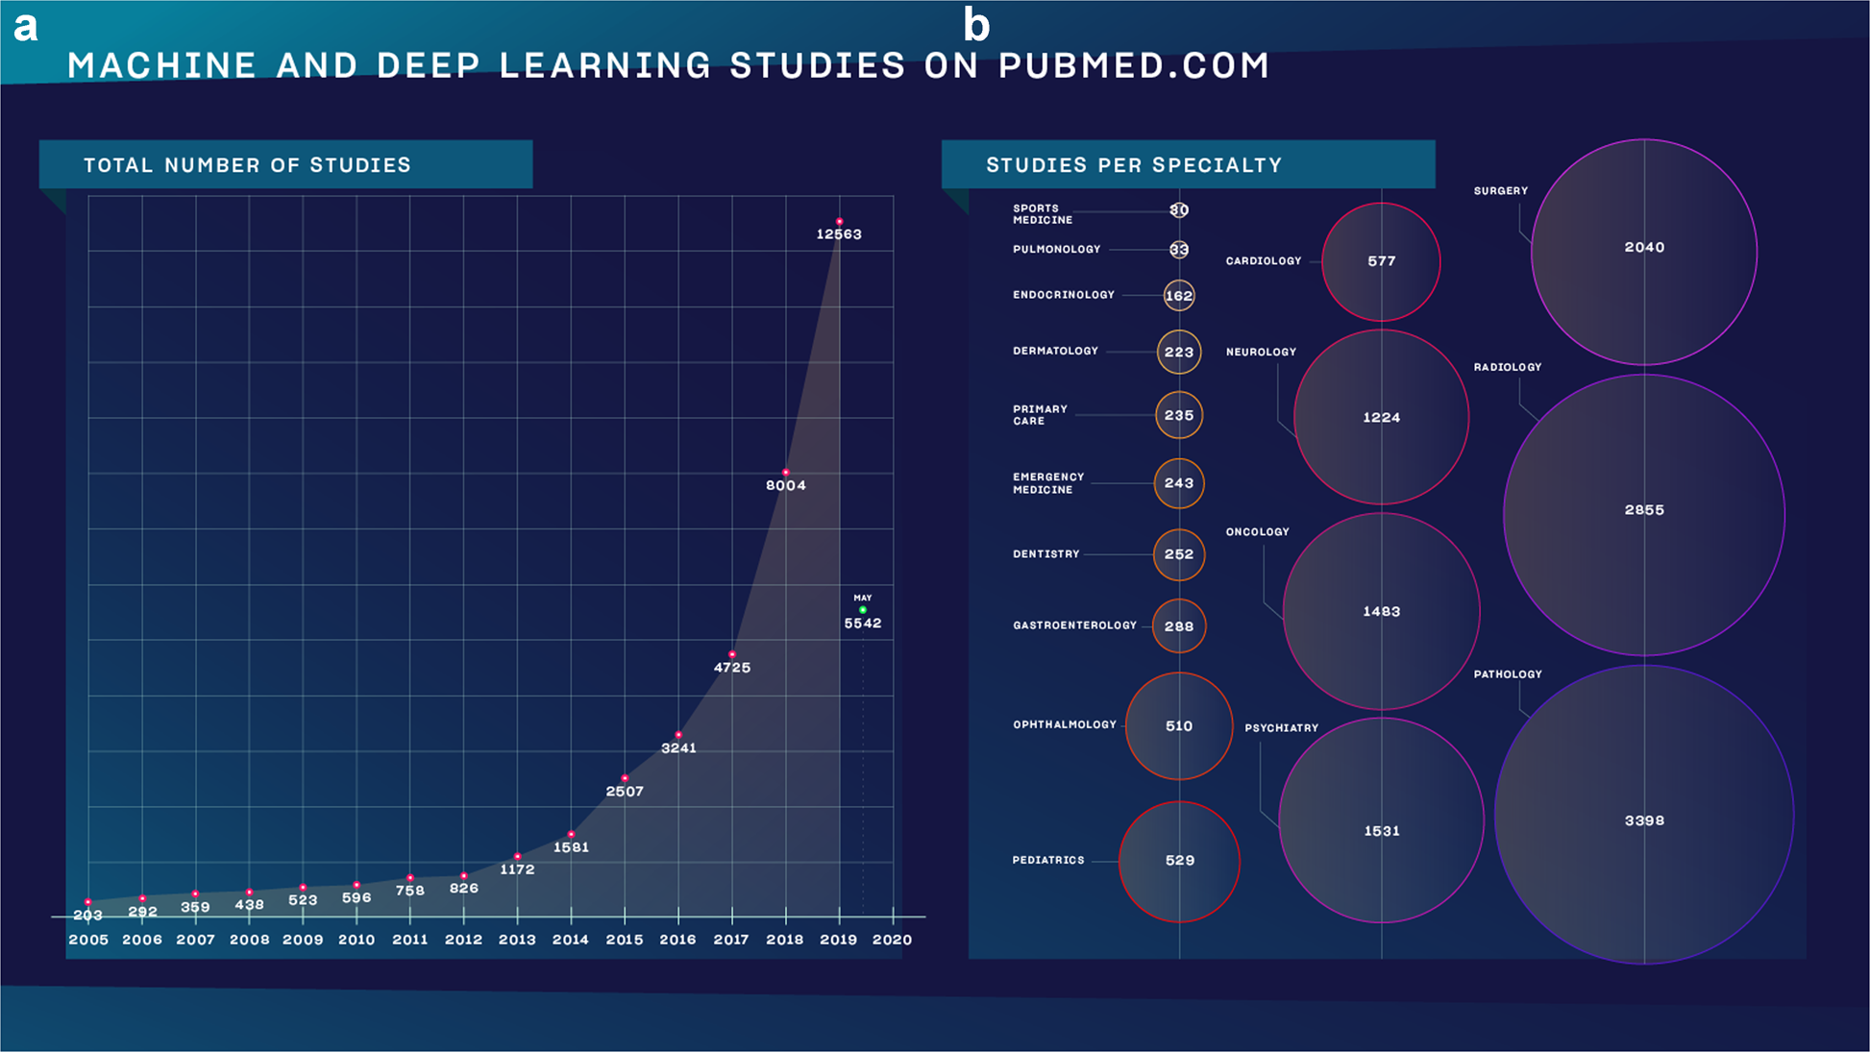
deep learning
Meskó, B., Görög, M. A short guide for medical professionals in the era of artificial intelligence. npj Digit. Med. 3, 126 (2020)
Notes:
Also convex!

Slide 3
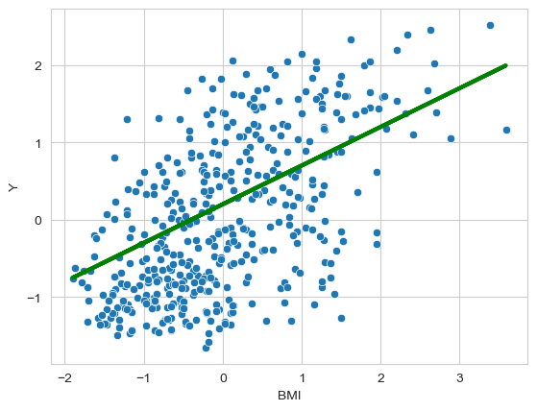
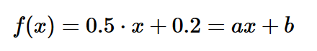
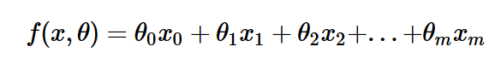
linear regression
a and b are model parameters
a is the slope to the line (direction)
b is the intercept or bias (position)

Slide 4
linear regression
More inputs,
More parameters

Slide 5
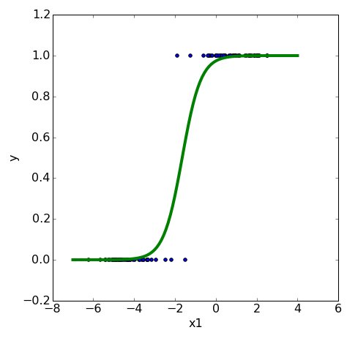
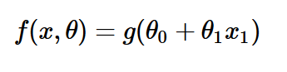
logistic regression
More inputs,
More parameters

Slide 6
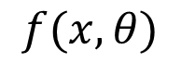
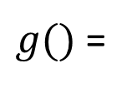
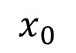
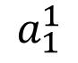
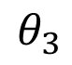
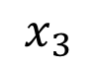
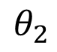
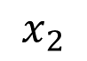
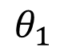
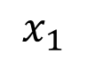
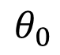
neural network
We can visualize a logistic regression model as follows:
$$x_{0}$$
$$θ_{0}$$
$$x_{1}$$
$$θ_{1}$$
$g()$ =
$$a_{1}^{1}$$
$$f(x,θ)$$
$$θ_{2}$$
$$x_{2}$$
$$θ_{3}$$
$$x_{3}$$
Notes:
Also convex!

Slide 7
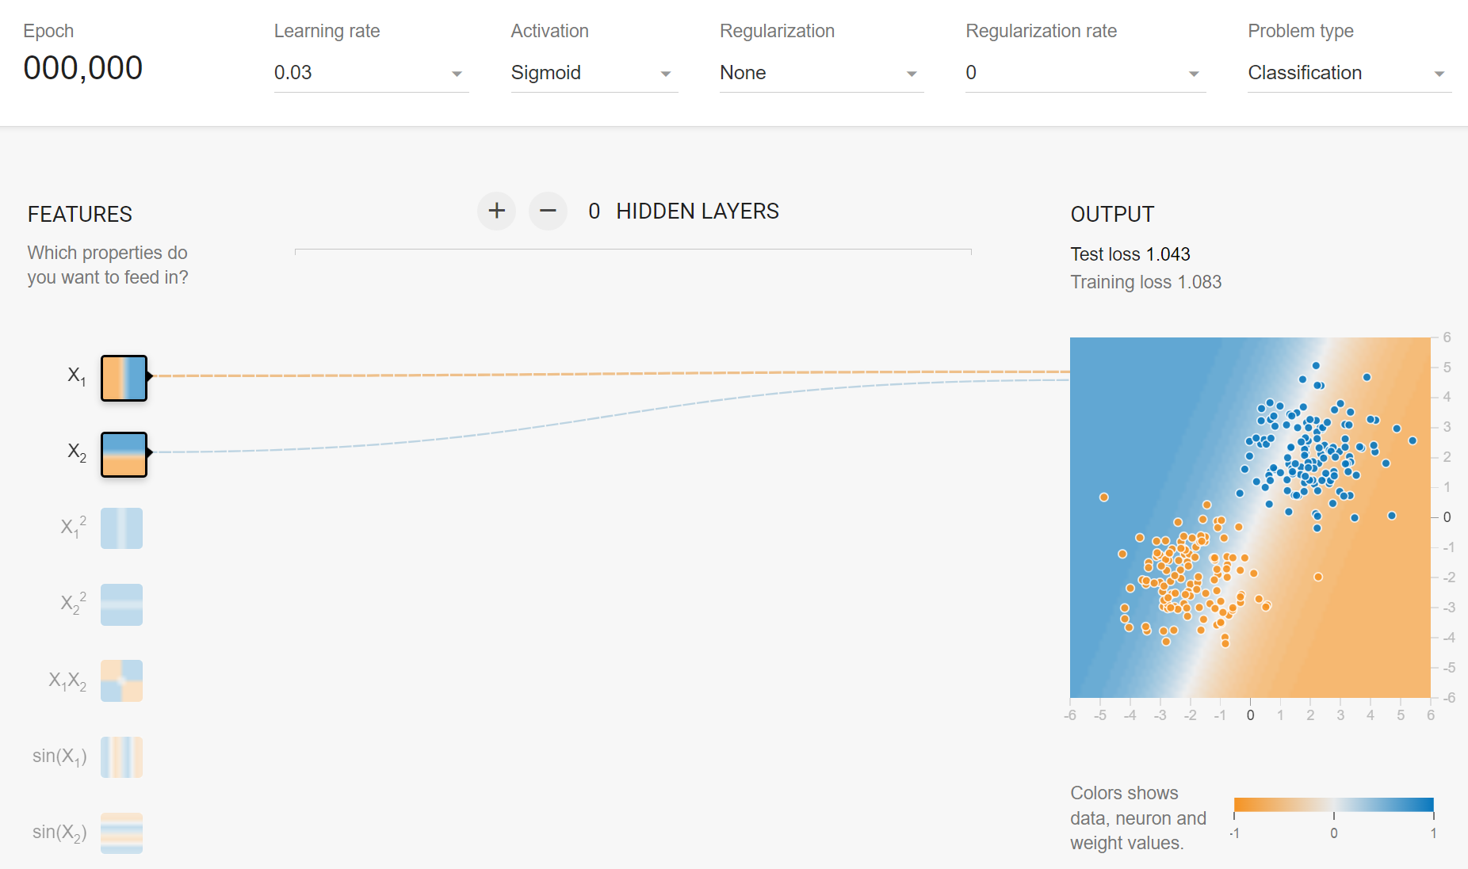
neural network
We can visualize a logistic regression model as follows (ctrl-click image):
Notes:
Also convex!

Slide 8
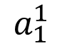
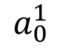
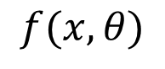
neural network
A neural network is an architecture that consists of many logistic regressions:
An additional logistic model is added as a node in the model’s first (hidden) layer.
$$x_{0}$$
$$x_{1}$$
$$a_{0}^{1}$$
$$x_{2}$$
$$a_{1}^{1}$$
$$f(x,θ)$$
$$x_{3}$$
Notes:
Also convex!

Slide 9
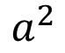
neural network
A neural network is an architecture that consists of many logistic regressions:
An additional logistic model is added as a node in the model’s first (hidden) layer, followed by a logistic regression model in the output layer.
$$x_{0}$$
$$x_{1}$$
$$a_{0}^{1}$$
$$x_{2}$$
$$a_{1}^{1}$$
$$a^{2}$$
$$f(x,θ)$$
$$x_{3}$$
Notes:
Also convex!

Slide 10
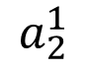
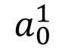
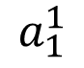
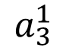
neural network
A neural network is an architecture that consists of many logistic regressions:
More additional logistic models can be added as nodes in the model’s first (hidden) layer, followed by a logistic regression model in the output layer.
$$x_{0}$$
$$a_{0}^{1}$$
$$x_{1}$$
$$a_{1}^{1}$$
$$x_{2}$$
$$a_{2}^{1}$$
$$a^{2}$$
$$f(x,θ)$$
$$x_{3}$$
$$a_{3}^{1}$$
…
Notes:
Also convex!

Slide 11
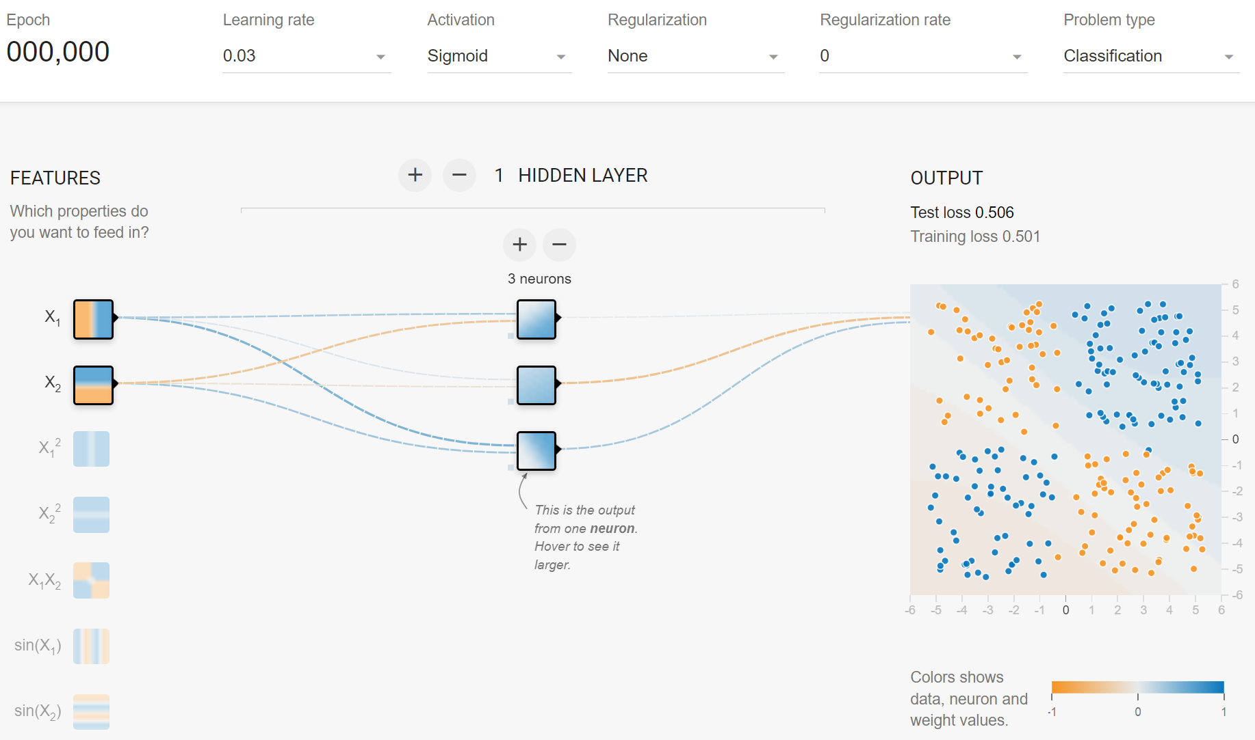
neural network
A neural network is an architecture that consists of logistic models (ctrl-click image):
More additional logistic models can be added as nodes in the model’s first (hidden) layer, followed by a logistic regression model in the output layer.
Notes:
Also convex!

Slide 12
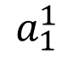
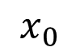
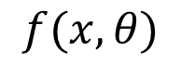
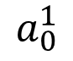
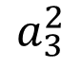
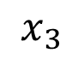
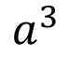
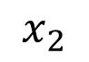
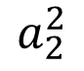
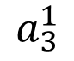
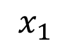
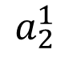
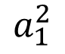
(deep) neural network
A neural network is an architecture that consists of many logistic regressions:
We can also add a second (or more) layer of nodes to the model, followed by an output layer.
$$x_{0}$$
$$a_{0}^{1}$$
$$x_{1}$$
$$a_{1}^{1}$$
$$a_{1}^{2}$$
$$a^{3}$$
$$f(x,θ)$$
$$x_{2}$$
$$a_{2}^{1}$$
$$a_{2}^{2}$$
$$x_{3}$$
$$a_{3}^{1}$$
$$a_{3}^{2}$$
…
…
Notes:
Also convex!

Slide 13
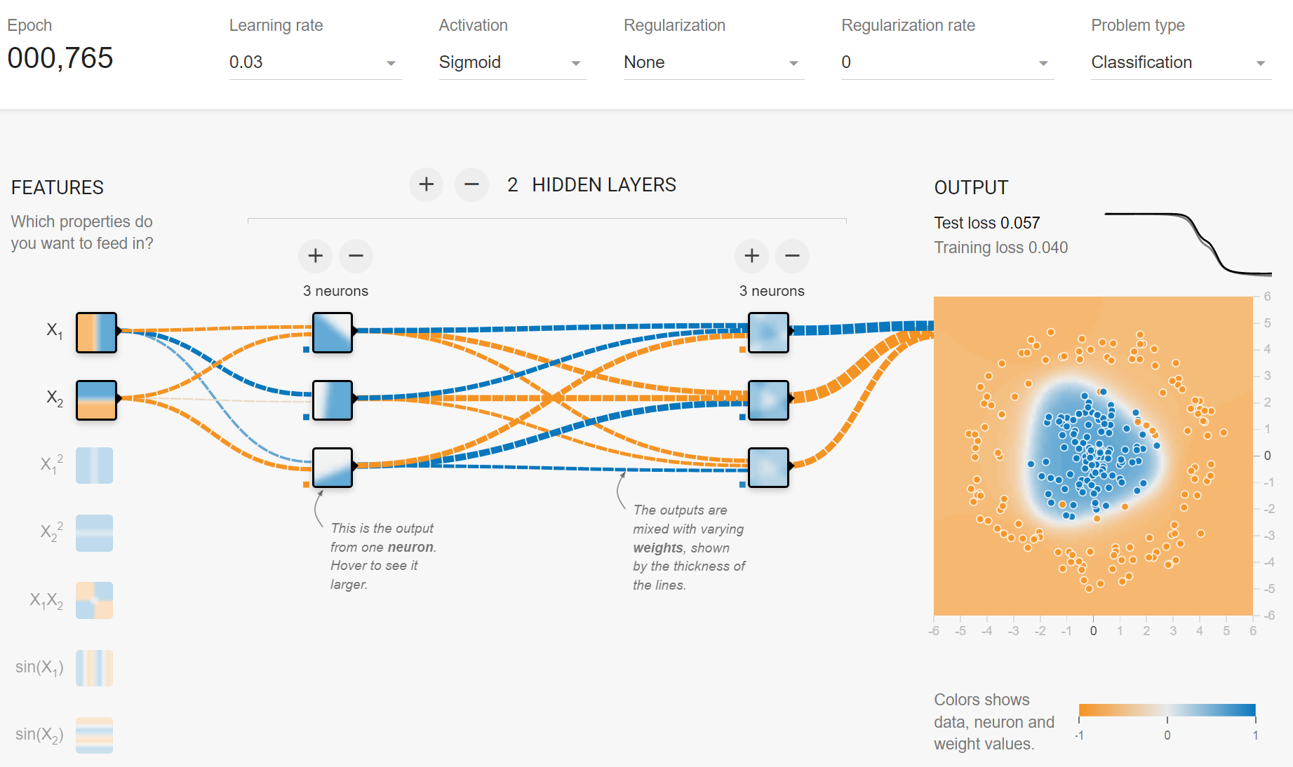
(deep) neural network
A neural network is an architecture that consists of logistic models (ctrl-click image):
We can also add a second (or more) layer of nodes to the model, followed by an output layer.
Notes:
Also convex!

Slide 14
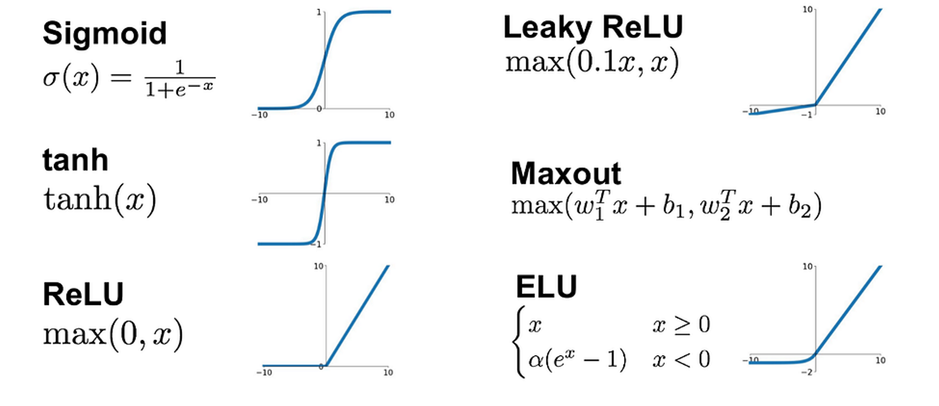
non-linearity: activation functions g()
We can employ different types of activation functions.
They need to be non-linear (and ‘differentiable…..ReLU?...’).
Notes:
Also convex!

Slide 15
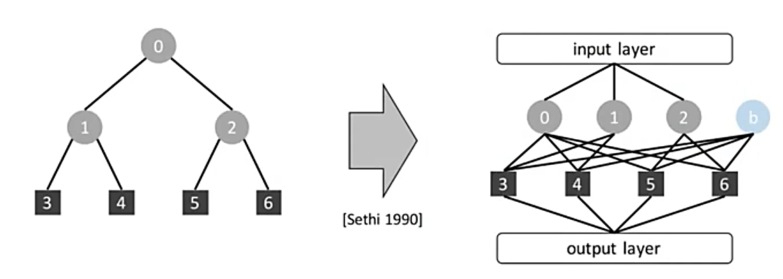
(deep) neural network
A neural network is somewhat similar to a decision tree.
hidden layer 1
hidden layer 2
Sethi I.K., Proceedings of the IEEE (1990)
Notes:
Also convex!

Slide 16
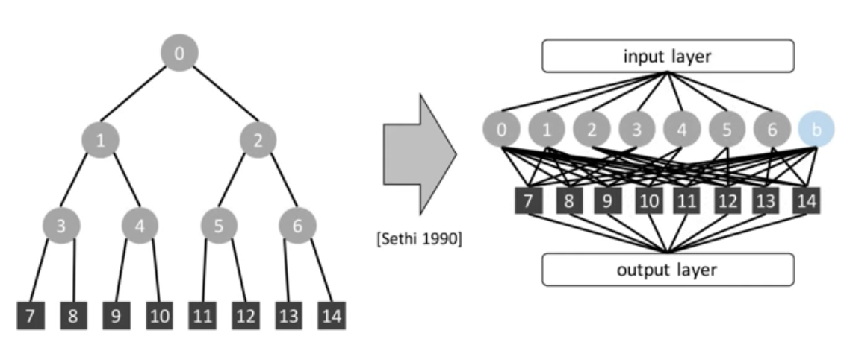
(deep) neural network
A neural network is somewhat similar to a decision tree.
Except that adding a level in a decision tree is the same as expanding the first hidden layer in a neural network. This means that neural networks can learn much more complex functions by adding hidden layers.
hidden layer 1
hidden layer 2
Sethi I.K., Proceedings of the IEEE (1990)
Notes:
Also convex!

Slide 17
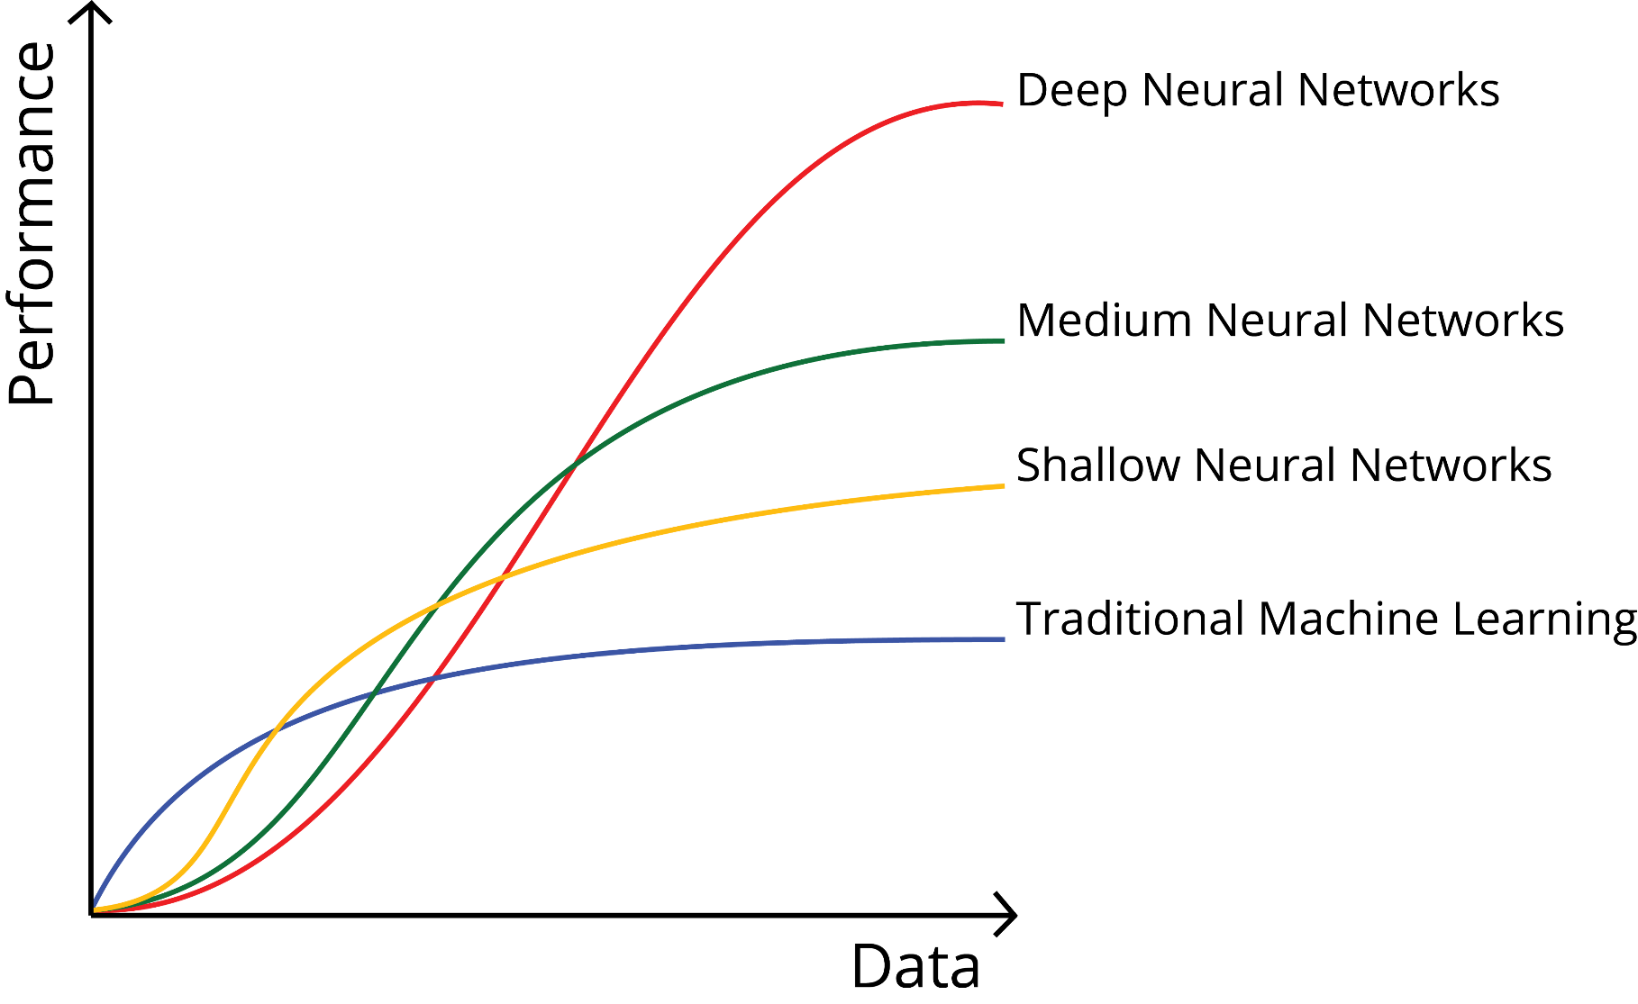
deep neural networks
Notes:
Also convex!

Slide 18
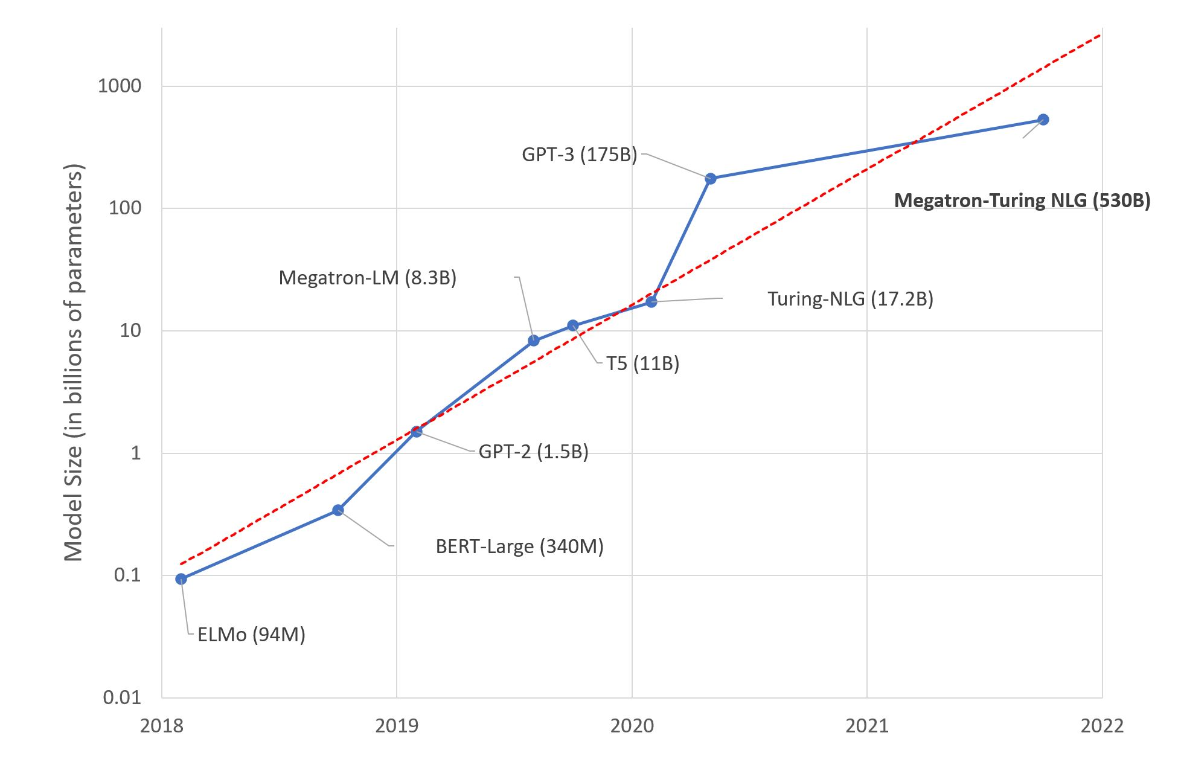
deep neural networks
AI is (for a large part) about scaling things up (logistic regression on steroids).
https://huggingface.co/blog/large-language-models
Notes:
Also convex!

Slide 19
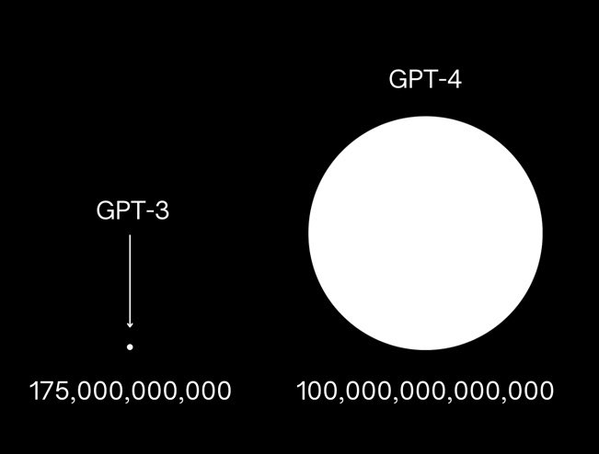
deep neural networks
AI is (for a large part) about scaling things up (logistic regression on steroids).
https://openai.com/product/gpt-4
Notes:
Also convex!

Slide 20
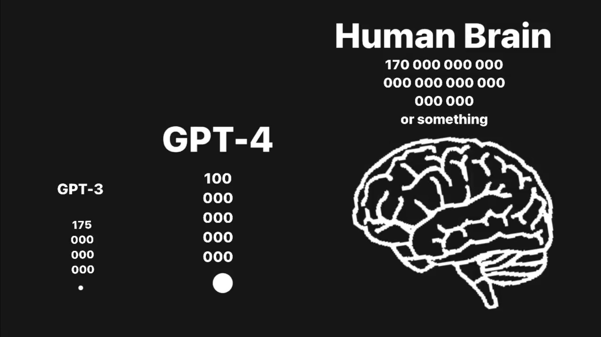
deep neural networks
AI is (for a large part) about scaling things up (logistic regression on steroids).
https://openai.com/product/gpt-4
Notes:
Also convex!

Slide 21
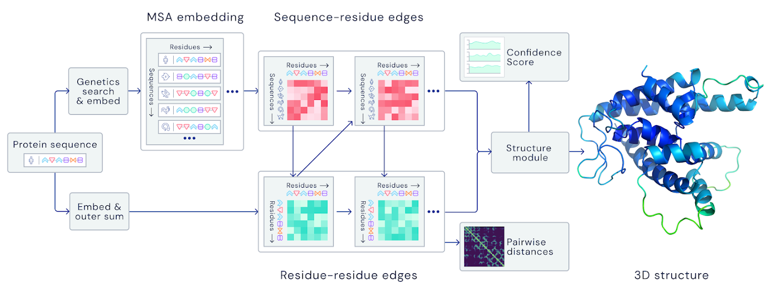
deep neural networks
AI is (for a large part) about scaling things up (logistic regression on steroids).
21 million parameters
https://www.nature.com/articles/s41586-021-03819-2
Notes:
Also convex!

Slide 22










loss function
This function computes the “distance” between the output of the model and the expected output.
It defines the error the model makes.
$$x_{0}^{i}$$
$$a_{0}^{1}$$
$$x_{1}^{i}$$
$$a_{1}^{1}$$
$$x_{2}^{i}$$
$$a_{2}^{1}$$
$$a^{2}$$
$${\hat{y}}^{i}$$
$$x_{3}^{i}$$
$$a_{3}^{1}$$
…
Notes:
Also convex!

Slide 23

loss function
For a regression task we use the Mean Squared Error (MSE) also known as L2 loss.
$$\frac{1}{n}{\sum_{i=1}^{n}{(y^{i}}−{\hat{y}}^{i})}^{2}$$
$$x_{0}^{i}$$
$$a_{0}^{1}$$
$$x_{1}^{i}$$
$$a_{1}^{1}$$
$$x_{2}^{i}$$
$$a_{2}^{1}$$
$$a^{2}$$
$${\hat{y}}^{i}$$
$$x_{3}^{i}$$
$$a_{3}^{1}$$
…
Notes:
Also convex!

Slide 24


loss function
For a two-class (or binary) classification task we use the Binary Cross Entropy (BCE) loss.
$$−\sum_{i=1}^{n}{(y^{i}\log\left({\hat{y}}^{i}\right)+\left(1−y^{i}\right)log⁡(1−{\hat{y}}^{i})}$$
$$x_{0}^{i}$$
$$a_{0}^{1}$$
$$x_{1}^{i}$$
$$a_{1}^{1}$$
sigmoid
$$x_{2}^{i}$$
$$a_{2}^{1}$$
$${\hat{y}}^{i}$$
$$x_{3}^{i}$$
$$a_{3}^{1}$$
…
Notes:
Also convex!

Slide 25








loss function
For a multi-class classification task we use the Categorical Cross Entropy (CE) loss.
$$−\sum_{j=1}^{C}{(y^{i}\log\left({\hat{y}}^{i}\right)}$$
$$x_{0}^{i}$$
$$a_{0}^{1}$$
softmax
$$\frac{e^{{\hat{y}}_{j}^{i}}}{\sum_{j=1}^{C}{e^{{\hat{y}}_{j}^{i}}}}$$
$$x_{1}^{i}$$
$$a_{1}^{1}$$
$${\hat{y}}_{1}^{i}$$
$${\hat{y}}_{1}^{i}$$
$$x_{2}^{i}$$
$$a_{2}^{1}$$
$${\hat{y}}_{2}^{i}$$
$${\hat{y}}_{2}^{i}$$
$$x_{3}^{i}$$
$$a_{3}^{1}$$
$${\hat{y}}_{3}^{i}$$
$${\hat{y}}_{3}^{i}$$
…
…
Notes:
Also convex!

Slide 26






loss function
For a multi-class classification task we use the Categorical Cross Entropy (CE) loss.
$$−\sum_{j=1}^{C}{(y^{i}\log\left({\hat{y}}^{i}\right)}$$
$$x_{0}^{i}$$
$$a_{0}^{1}$$
softmax
$$\frac{e^{{\hat{y}}_{j}^{i}}}{\sum_{j=1}^{C}{e^{{\hat{y}}_{j}^{i}}}}$$
$$x_{1}^{i}$$
$$a_{1}^{1}$$
$$1$$
$$0.001$$
$$x_{2}^{i}$$
$$a_{2}^{1}$$
$$2$$
$$0.002$$
$$x_{3}^{i}$$
$$a_{3}^{1}$$
$$8$$
$$0.997$$
…
…
Notes:
Also convex!

Slide 27

neural network training
The algorithm used to train a neural network is called backpropagation.
It fine-tunes the weights of a neural net based on the error rate (i.e. loss) obtained in the previous epoch (i.e. iteration).
Notes:
Also convex!

Slide 28




gradient descent

Slide 29

backpropagation
https://youtu.be/Ilg3gGewQ5U?si=hvb1oqZ-GgHn3kl9&t=409
Notes:
Also convex!

Slide 30

backpropagation
https://youtu.be/Ilg3gGewQ5U?si=hvb1oqZ-GgHn3kl9&t=409

Slide 31

https://youtu.be/Ilg3gGewQ5U?si=hvb1oqZ-GgHn3kl9&t=409

Slide 32

https://youtu.be/Ilg3gGewQ5U?si=hvb1oqZ-GgHn3kl9&t=409

Slide 33

https://youtu.be/Ilg3gGewQ5U?si=hvb1oqZ-GgHn3kl9&t=409

Slide 34

loss function
Training is
a challenge.
logistic regression (small) neural network

Slide 35

loss function
Training is
a challenge.
Loss surface can
be highly
non-convex.
(deep neural network)
https://izmailovpavel.github.io/curves_blogpost/
Notes:
Advanced: https://www.youtube.com/watch?v=Ilg3gGewQ5U&ab_channel=3Blue1Brown

Slide 36

stochastic gradient descent (SGD)
Gradient descent (GD) takes into consideration the complete training dataset through every iteration, which may become time-consuming and computationally expensive.
GD may converge to a local minimum and may not be able to get away from it.
SGD takes into consideration one random data point through every iteration, which may lead to noisier results than the GD and may allow escaping local minima.
Notes:
Advanced: https://www.youtube.com/watch?v=Ilg3gGewQ5U&ab_channel=3Blue1Brown

Slide 37

mini batch gradient descent
Mini batch gradient descent is a cross-over between GD and SGD. Instead of iterating through the entire dataset (GD) or one observation (SGD), we split the dataset into small subsets (batches) and compute the gradients for each batch.
Notes:
Advanced: https://www.youtube.com/watch?v=Ilg3gGewQ5U&ab_channel=3Blue1Brown

Slide 38
modules
AI is (for a large part) about scaling things up (logistic regression on steroids).
modules == building block == transformation == function
A module receives as input either data 𝑥 or another module’s output.
A module returns an output based on its activation function.
A module may or may not have trainable model parameters.
Notes:
Also convex!

Slide 39

modules
Complex hierarchies of modules.
Fjodor van Veen from Asimov institute
Notes:
Also convex!

Slide 40
encoder – decoder (autoencoder)
An autoencoder architecture learns an efficient embeddings of unlabeled data.
It consists of two parts, an encoder, and a decoder.
The encoder compresses the data from a higher-dimensional space to a lower-dimensional space (also called the latent space)
The decoder does the opposite i.e., convert the latent space back to higher-dimensional space.
latent space (embedding)
encoder
decoder

Slide 41

encoder – decoder (autoencoder)

Slide 42

encoder – decoder (autoencoder)

Slide 43

encoder – decoder (autoencoder)

Slide 44


encoder – decoder (denoising autoencoder)
Autoencoders can easily be trained to denoise image data, expression data, …
The principle is to force the latent space layer capture the most robust features by reconstructing a clean input from a corrupted one.

Slide 45








matrix representation of weights, biases, and activations
matrix representation of weights, biases, and activations
$$w_{0,0}$$
$$a_{0}^{0}$$
$$a_{0}^{1}$$
$a_{0}^{1}=σ(w_{0,0}∙a_{0}^{0}+w_{0,1}∙a_{1}^{0}+ …+w_{0,n}∙a_{1}^{0}+b_{0})$
$$w_{0,1}$$
$$a_{1}^{0}$$
…
$$w_{0,n}$$
$$⋯$$
$$a_{k}^{0}$$

Slide 46



matrix representation of weights, biases, and activations
matrix representation of weights, biases, and activations
$$a_{0}^{0}$$
$$a_{0}^{1}$$
$a_{0}^{1}=σ(w_{0,0}∙a_{0}^{0}+w_{0,1}∙a_{1}^{0}+ …+w_{0,n}∙a_{n}^{0}+b_{0})$
$$a_{1}^{0}$$
$$a_{1}^{1}$$
$a_{1}^{1}=σ(w_{1,0}∙a_{0}^{0}+w_{1,1}∙a_{1}^{0}+ …+w_{1,n}∙a_{n}^{0}+b_{1})$
$$⋯$$
$$⋯$$
$$…$$
$$a_{k}^{0}$$
$$a_{n}^{1}$$
$a_{n}^{1}=σ(w_{k,0}∙a_{0}^{0}+w_{k,1}∙a_{1}^{0}+ …+w_{k,n}∙a_{n}^{0}+b_{n})$

Slide 47


matrix representation of weights, biases, and activations
matrix representation of weights, biases, and activations
$$a_{0}^{0}$$
$$a_{0}^{1}$$
$a_{0}^{1}=σ(w_{0,0}∙a_{0}^{0}+w_{0,1}∙a_{1}^{0}+ …+w_{0,n}∙a_{n}^{0}+b_{0})$
$$a_{1}^{0}$$
$$a_{1}^{1}$$
$a_{1}^{1}=σ(w_{1,0}∙a_{0}^{0}+w_{1,1}∙a_{1}^{0}+ …+w_{1,n}∙a_{n}^{0}+b_{1})$
$$⋯$$
$$⋯$$
$$…$$
$$a_{k}^{0}$$
$$a_{n}^{1}$$
$a_{n}^{1}=σ(w_{k,0}∙a_{0}^{0}+w_{k,1}∙a_{1}^{0}+ …+w_{k,n}∙a_{n}^{0}+b_{n})$
$$\left[\begin{matrix}a_{0}^{1} \\ a_{1}^{1} \\ ⋮ \\ a_{n}^{1}\end{matrix}\right]=\left[\begin{matrix}w_{0,0} & w_{0,1} & ⋯ & w_{0,n} \\ w_{1,0} & w_{1,1} & ⋯ & w_{1,n} \\ ⋮ & ⋮ & ⋱ & ⋮ \\ w_{k,0} & w_{k,1} & ⋯ & w_{k,n}\end{matrix}\right]\left[\begin{matrix}a_{0}^{0} \\ a_{1}^{0} \\ ⋮ \\ a_{n}^{0}\end{matrix}\right]+\left[\begin{matrix}b_{0} \\ b_{1} \\ ⋮ \\ b_{n}\end{matrix}\right]$$
$$a^{1}=σ(W^{1}∙a^{0}+b^{1})$$

Slide 48


